Slide 1
Text Summarisation
Reducing potential noises in constructing a knowledge graph

Slide 2


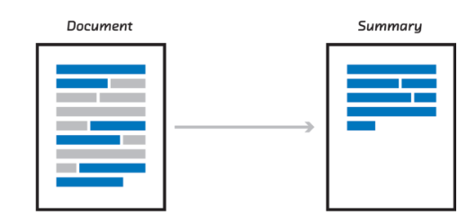




Overview – Our focus
OBJECTIVE
STAGES
GOAL
METRICS
Extractive: Obtain relevant sentences from a large corpus of documents
To create an interactive chatbot that is able to answer questions pertaining to a set of relevant documents
Text Reduction
Performance
Functionality
Satisfaction
Abstractive: Reduce data further while preserving key information
Text Summarization
Splitting a sentence into (object, subject, predicate) triples
Fact Extraction

Slide 3
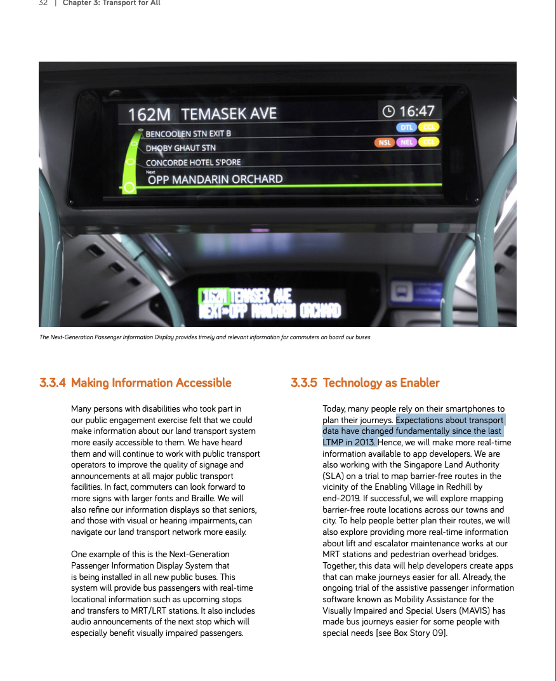
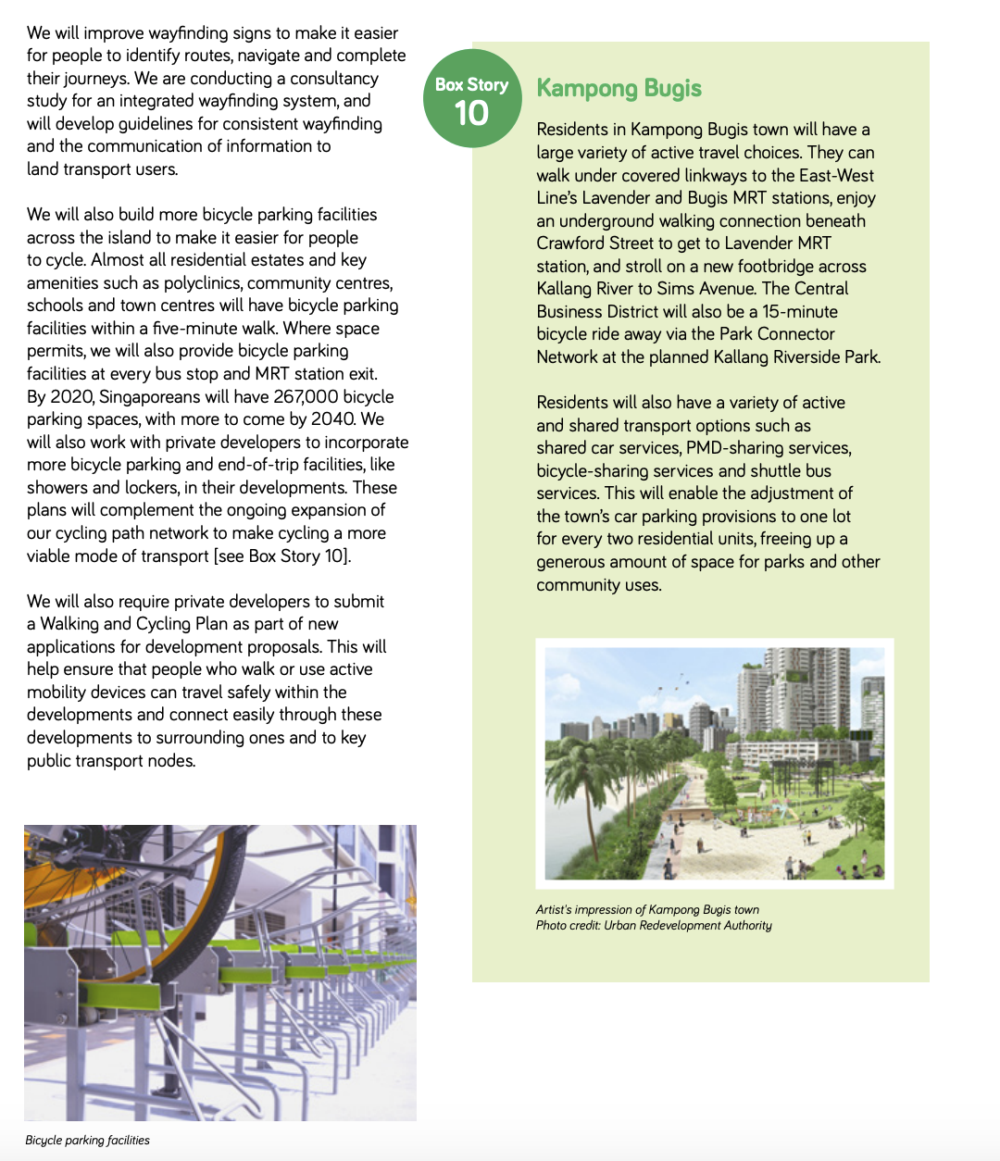
Simplifying texts from document to extract facts
Texts from documents
Reduce
Grouping of similar sentences at meaning level to find most representative sentences of facts
Summarise
Reduce complex sentences into a simpler sentence/simpler sentences
Fact Extract
Extract facts from data
Autonomous vehicles (AVs) could radically transform our land transport system by enabling more efficient dynamically-routed or on-demand forms of shared transport
Autonomous vehicles (AVs) could change land transport system
<subject – autonomous vehicles>
<relation – change>
<object – land transport system>

Slide 4
Recognising the nature of texts before achieving well-summarised texts
Standalone sentences
Autonomous vehicles (AVs) could radically transform our land transport system by enabling more efficient dynamically-routed or on-demand forms of shared transport.
Expectation of Summarised Text
Interrelated sentences across paragraphs
The output should have a reduction in total length, yet at the same time retain its semantics.
The new system allows trains to run more closely to each other, reducing intervals and creating shorter waiting times.
…
…
… Better speed, location and condition-tracking will offer smoother, safer and more reliable rides.

Slide 5
Using Deep Learning to Summarise Sentence: Recurrent Neural Networks
Autonomous vehicles (AVs) will also become a reality and could radically transform our land transport system
Autonomous vehicles will change our transport system
Refer to train output
INPUT
Start off with equal importance to all words in input sentence
OUTPUT
Revise weightage to input words relevant to generate output

Slide 6
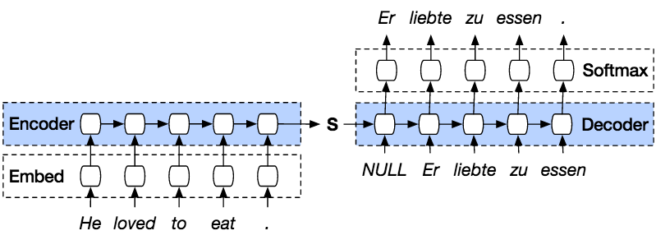






Encoding text to machine readable inputs
Change our transportation system
Refer to train output
However, RNN implicitly places emphasis to more recent data and may “forget” importance of earlier words
$$\begin{matrix}0.33 \\ ⋮ \\ 0.54\end{matrix}$$
$$\begin{matrix}0.23 \\ ⋮ \\ 0.18\end{matrix}$$
$$\begin{matrix}0.11 \\ ⋮ \\ 0.21\end{matrix}$$
$$\begin{matrix}0.58 \\ ⋮ \\ 0.28\end{matrix}$$
512
dimension
$$\begin{matrix}0.00 \\ ⋮ \\ 0.99\end{matrix}$$
Revise weightage to input words relevant to generate output
Radically transform our transportation system

Slide 7
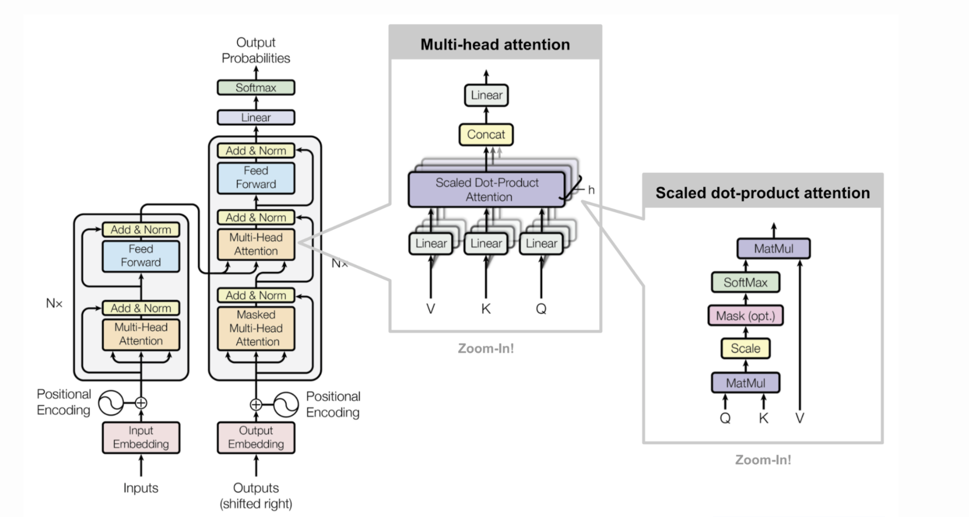
Overcoming the limits of RNN with Attention Mechanism Seq2Seq: Our Baseline Model
Text Input
Text Output
Autonomous
vehicles
will
also
become
a
reality
and
could
radically
transform
our
land
transport
system
Autonomous
vehicles
will
become
a
reality
and
change
land
transport
Down emphasize
Up emphasize
Down emphasize
Down emphasize
Self-attention mechanism
Up emphasize
Text
Input
Text
Output
Context vector to “downplay” less important words and “emphasize” essential words holistically across entire sentence

Slide 8
Seq2Seq performs summarisation but we cannot tune the outputs explicitly
OVERSIMPLIFIED
Autonomous vehicles change transport
Autonomous vehicles (AVs) will also become a reality and could radically transform our land transport system
Vehicles can transform land transport system
MEANING CHANGED
Autonomous vehicles (AVs) will also be realized and could dramatically transform our land transport system
LITTLE SUMMARISATION
Autonomous vehicles will transform land transportation
WHAT WE WANT

Slide 9

An Approach to enable Tuneable Summarised Texts
Compression (Length) | Paraphrase (Simplify) | Lexical (Simple Words) | Syntactic (Simple Structure)
Reduction of sentence lengths | Simplify without losing meaning of original sentence | Turn complex words to common ones | Grammatically simple to understand than to phrase in convoluted sentences
Parameters to explicitly control summarised outputs
NbChars | LevSim | WordRank | DepTreeDepth
Character length ratio between source sentence and target sentence | Amount of modification operated on the source sentence – word add/deletes | Word complexity may be proxied by word frequency | Text dependency tree of word-word relations in a sentence

Slide 10
Essential difference of a Seq2Seq from Controllable Model
Seq2Seq
Controllable
Complex Sentence
Prepend control parameters into original input source
4 Parameters
+
Complex Sentence
Simple sentence
Simple sentence
Input Source:
He settled in London, devoting himself chiefly to practical teaching.
Output Target:
He teaches in London.
Input Source:
<NbChars_0.3> <LevSim_0.4> He settled in London, devoting himself chiefly to practical teaching.
Output Target:
He teaches in London.

Slide 11
Comparing the Approaches… Original: Autonomous vehicles (AVs) will also become a reality and could radically transform our land transport system by enabling more efficient dynamically-routed or on-demand forms of shared transport
Seq2Seq Output Benchmark Autonomous will also become a reality and could radically transform our land transport system.
Length | Paraphrasing | Lexical Complexity | Syntactical Complexity | Output
1 | 1 | 1 | 1 | Autonomous vehicles (AVs) will also become a reality and could radically transform our land transport system by enabling more efficient dynamically-routed or on-demand forms of shared transport.
1 | 0.75 | 0.75 | 0.25 | Autonomous vehicles ( AVs ) will also become a reality and could change our land transport system. This allows more efficient dynamically-rout forms of shared transport.
0.5 | 0.75 | 0.75 | 0.5 | Autonomous vehicles ( AVs ) will also become a reality and could change our land transport system.
0.25 | 0.25 | 0.25 | 0.25 | Autonomous vehicles ( AVs ) is a type of vehicle.
Tuneable predictions to suit needs of task and option to calibrate outputs

Slide 12
Model Evaluations
 | Speed | Simplicity of Outputs | Flexibility of Outputs | Accuracy
Classical Seq2Seq | Recurrent Neural Network based, not easily parallelisable | Dependant on training data and its quality | Fixed | Debatable; Accuracy of Controllable Network can be fine-tuned ex post of model training but not guaranteed better accuracy Evaluation Metric: SARI Seq2Seq – 38.7 Controllable: 41.48
Controllable Network | Transformer architecture, ease to parallelise | Depends on user-inputs into model | Can calibrate outputs according to needs
SARI: Measures “how good” words are added/deleted/kept after simplification, found to correlate with human judgement (higher scores associated with better human reviews)
Flexibility of Controllable Network allows customisation of summarised outputs, useful for fact extraction process when data found not to contain enough facts/too much noise to process

Slide 13
Future work and research areas
Incorporating controllable sequence summarization together with human effort into a deployable product:
Machine Aided Human Summarization
Human Aided Machine Summarization
Output from model highlights candidate sentences to be parsed by human for inclusion/exclusion
Post-processing on output of summarized sentences to refine the inputs that were used during summarization
Or as part of a pipeline for refinement of corpus for feature extraction that can be stored within a knowledge graph

Slide 14
Thank You

